Slide 1







MODULE 1:
INTRODUCTION AND CONCEPT OF GARDE MANGER

Slide 2
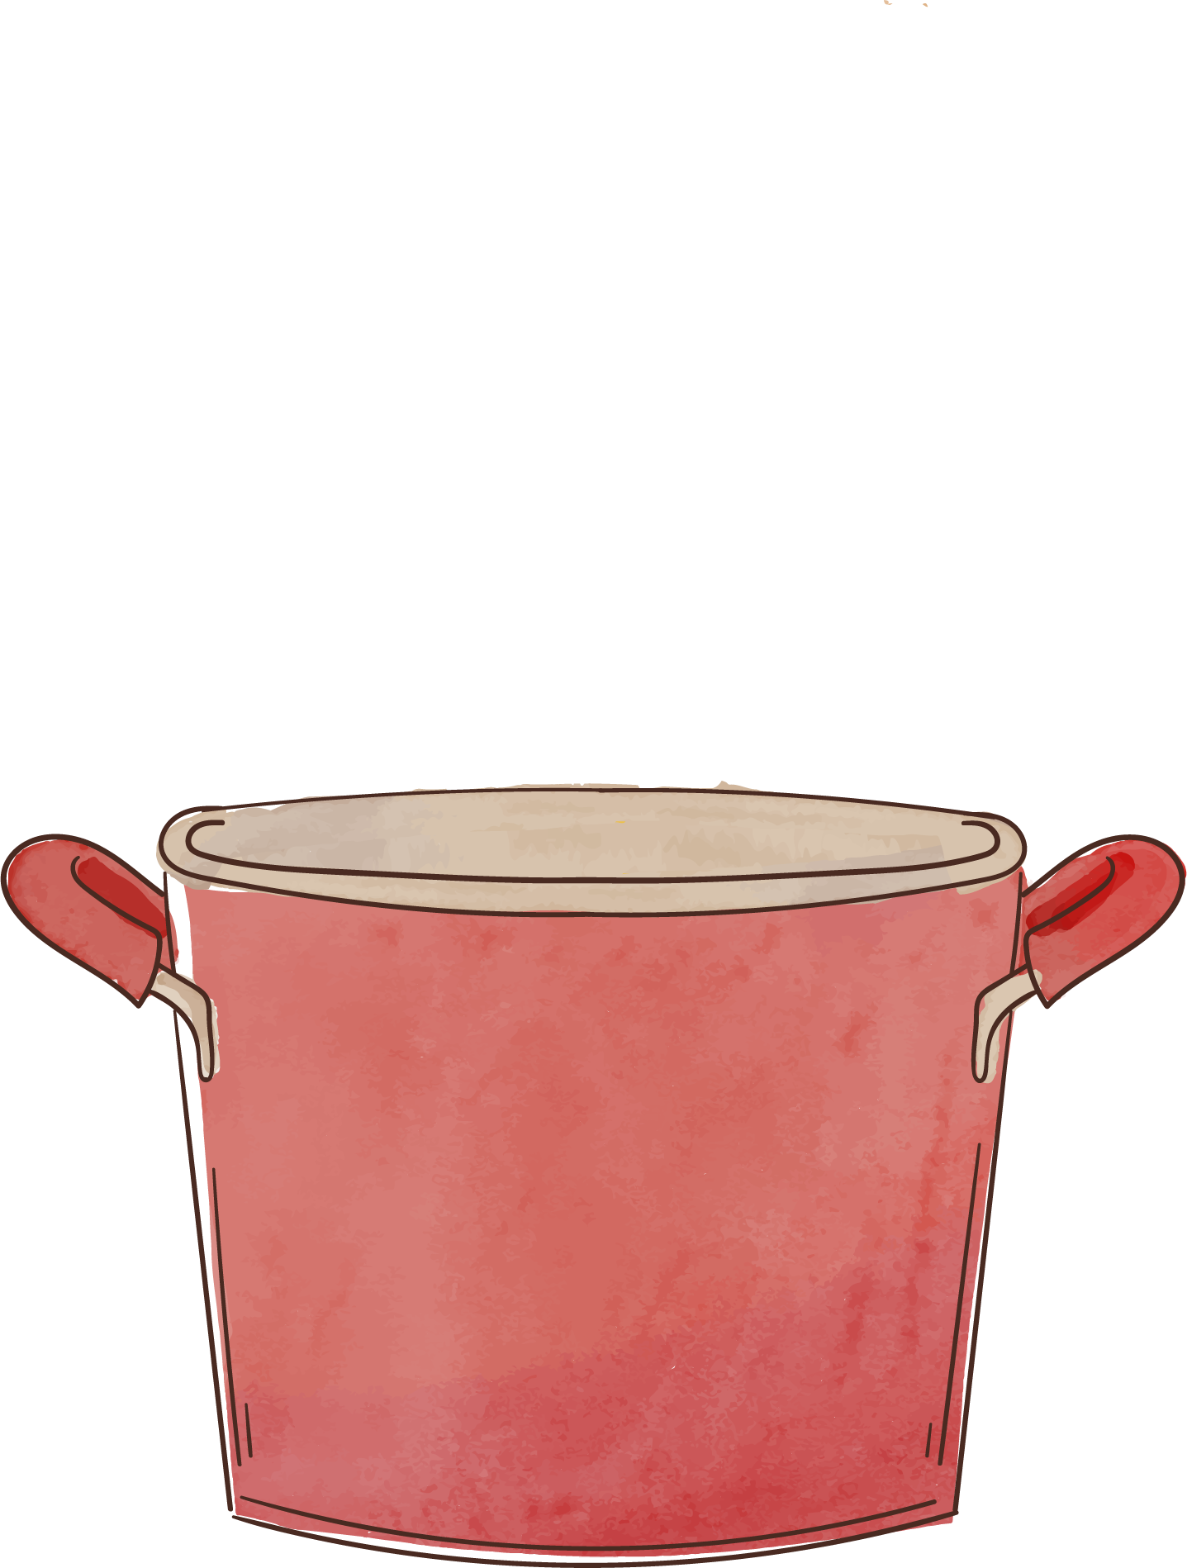
IMPORTANCE OF GARDE MANGER
In professional kitchens, the Garde Manger station is responsible for preparing salads, pâtés, terrines, and other cold appetizers. This station requires precision, creativity, and attention to detail, making it an essential component of any culinary team.

Slide 3
A GARDE MANGER
French for “keeper of the food” is a cool, well-ventilated area where cold dishes such as salads, hors d’oeuvres, appetizers, canapés, pâtés, terrines, are prepared and other foods are stored under refrigeration

Slide 4
The person in charge of this area is known as the Chef Garde Manger of pantry chef. Larger hotels and restuarants may have Garde Manger staff to perform additional duties, such as creating decorative elements of buffet presentation.

Slide 5

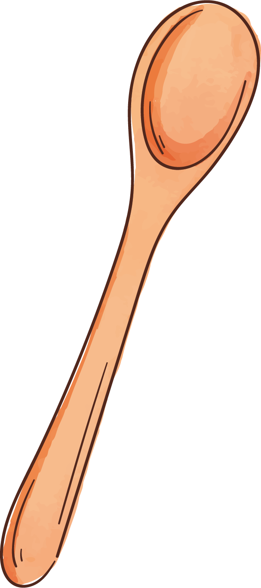


PRODUCTS OF GARDE MANGER

Slide 6
In the classical culinary arts, garde manger refers to a category of foods produced in the cold kitchen as well as the board array of tichniques used for preparing the food

Slide 7

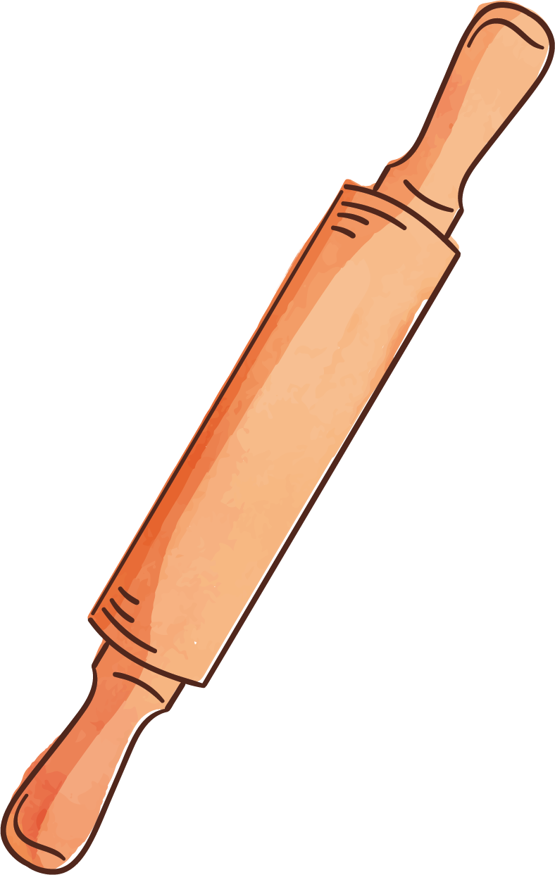


SOME EXAMPLE
1
SMOKE & CURED FOODS
1
SALAD & SALAD DRESSINGS
2
3
SAUSAGE, PATE & TERRINES

Slide 8
SOME EXAMPLE
CHEESE MAKING
4
5
PICKLED FOOD & CONDIMENTS
COLD SAUCES & AND SOUPS
6
GELATIN PRODUCTS
1
SMOKE & CURED FOODS
1
ASPIC
SALAD & SALAD DRESSINGS
2
COLEES
3
SAUSAGE, PATE & TERRINES
COLD SOUPS

Slide 9
GELATIN PRODUCTS
ASPIC
COLEES
COLD SOUPS
GELATIN PRODUCTS
CHAUFROID SAUCES
MOUSES, MOUSSELINE

Slide 10
GELATIN PRODUCTS
CHAUFROID SAUCES
MOUSES, MOUSSELINE
MARINATED PRODUCTS
SALAD
BRINES AND CURES

Slide 11
MARINATED PRODUCTS
SALAD
BRINES AND CURES
MARINATED PRODUCTS
SMOKED PRODUCTS
PICKLED PRODUCTS

Slide 12
MARINATED PRODUCTS
SMOKED PRODUCTS
PICKLED PRODUCTS
PIECE MONTE OR NON-EDIBLE DISPLAY
Ice carving
Tallow sculpture
Salt dough sculpture
Pastillage

Slide 13
PIECE MONTE OR NON-EDIBLE DISPLAY
Ice carving
Tallow sculpture
Salt dough sculpture
Pastillage
PIECE MONTE OR NON-EDIBLE DISPLAY
Fruit and vegetable display
Jelly logos
Thermocol display

Slide 14
PIECE MONTE OR NON-EDIBLE DISPLAY
Fruit and vegetable display
Jelly logos
Thermocol display
Cold Hors d’oeuvres
Sandwiches
Specially items such as, Caviar, Oyster, Snails, Foe gras, Cheese.

Slide 15
Cold Hors d’oeuvres
Sandwiches
Specially items such as, Caviar, Oyster, Snails, Foe gras, Cheese.

Slide 16
FUNCTION OF GARDE MANGER

Slide 17
The storage of all perishable raw food items which needs a storage temperature of minus-18 degree C

Slide 18
The storage of all prepared and cooked items like a cold appetizers, cold meats, cold sauces, salads and all cold items found on the Menu.

Slide 19
In order for the Larder to function properly it is essential that the Larder is separate from the hot kitchen and is located in a cool place but not very far.

Slide 20
Because the tradition of garde manger dates to an age before refrigeration, it encompasses many classical techniques for preparing and preserving foods.

Slide 21
Even before refrigeration, kitchen generally had one area that was constructed to maintain cool temperatures, usually a cellar of some kind

Slide 22
Here was where various methods of food preservation were employed, and sometimes invented, whether it was pickling, salting, or air-drying, all in service of the primary goal of preparing and serving food fit for the ruling class of the day

Slide 23
SUB-SECTION OF LARGE MANGER

Slide 24
The main responsibility is to cater to the requirements of the Hot Kitchen for raw materials such as fish fillets, steaks, and to supply the finished products as required by the room Service, Buffets, Banquets, for all colds dishes

Slide 25
The section of the Larder can be divided depending on the volume of work into;
BUTCHERY
FISH MONGERY
HORS D’OEUVRE / COLD SAUCES
SALADS
COLD BUFFETS

Slide 26
The area which processes raw materials like meat fish, is the Butchery and the Fish Mongery. Basic cuts are produced, marinated, roasted, smoked, or poached over here. The portion or cuts or joints are prepared according to the demand from thee different outlets with in the Hotel

Slide 27
EQUIPMENTS USED IN GARDE MANGER

Slide 28
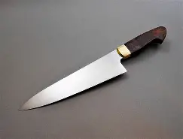
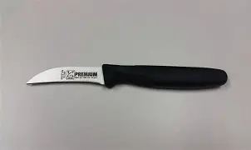
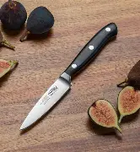
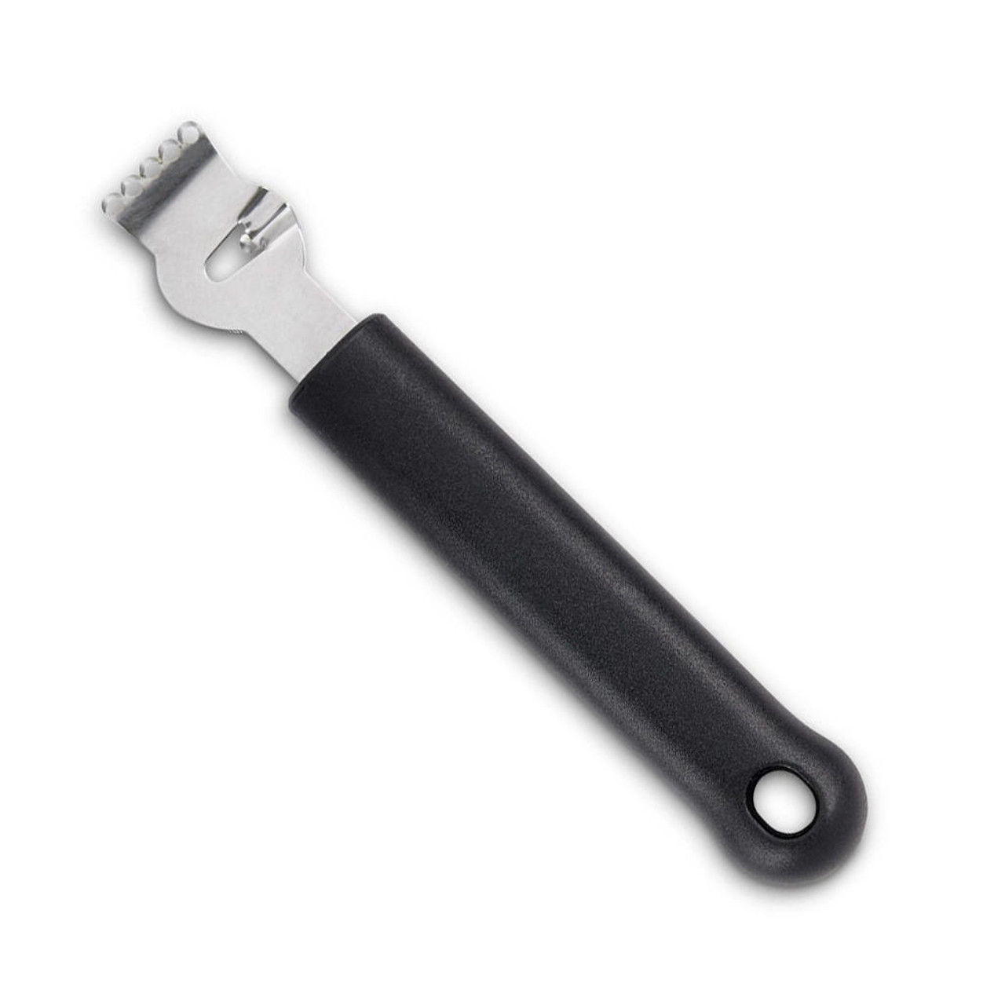

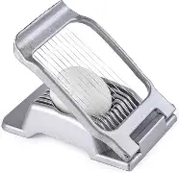
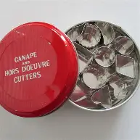
BASIC CUTTING TOOLS
FRENCH KNIFE
TURNING KNIFE
PARING KNIFE
CHANNEL KNIFE & ZESTER
WAFFLE CUTTER
MELON BALLER
SPIRAL CUTTER
EGG SLICER
CANAPES CUTTER

Slide 29
LARDER EQUEPMENT
Large or heavy duty equipment
Buffalo Chopper or Bowl chopper
Bone saw machine
Vegetable processor
Vacuum packing machines
Refrigerator
Steel work tables
Salamander
Fish kettle
Hanging rail system
Smoking machines

Slide 30
LARDER EQUEPMENT
Large or heavy duty equipment
Mincing machine
Gravity slicer or meat slicer
Dough mixer
Sandwich counter
Sausage stuffer
Grinding machine
Weighing scale
Butcher’s blocks
Steam kettle

Slide 31
TOOLS AND SMALL EQUIPMENT
Zester
Can and bottle openers
Pitters
Mandolin slicer
Boning knife
Oyster knife
Cheese knife
Sieves
Pie molds
Trauchelard
11. Trussing needles
12. Steak hammer
13. Brining syringe & pump
14. Channeller
15. Corer
16. Egg slicer
17. Butcher’ chopper and cleavers
18. Filleting knife

Slide 32
TOOLS AND SMALL EQUIPMENT
19. Bunts knife or wavy knife
20. Mezzaluna or mincing knife
21. Chinois
22. Terrine molds
23. Larding needles
24. Perisseinne scoops
25. Meat thermometers

Slide 33
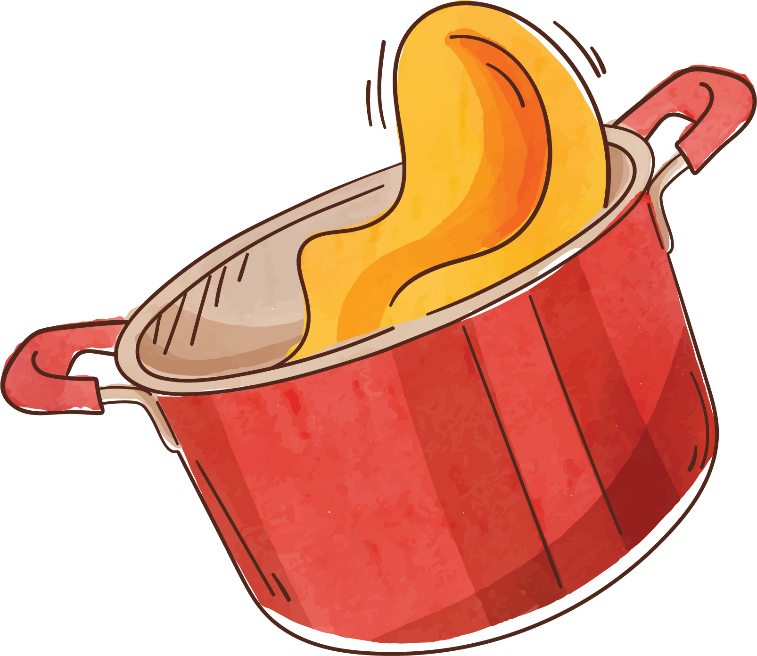
SPECIALTY TOOLS USE IN THE GARDE MANGER KITCHEN

Slide 34
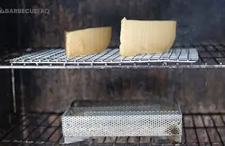
SMOKER
An appliance used to infuse a Smokey flavor to cheese and meats

Slide 35
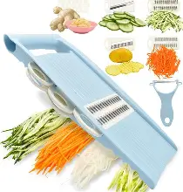
MANDOLIN
A flat framed cutting device with interchangeable blades used to cuts vegetable

Slide 36
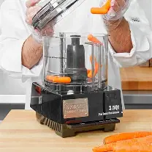
FOOD PROCESSOR
With attached blades used to emulsify salad dressings and puree foods as well as chops, shred, and slice vegetable

Slide 37
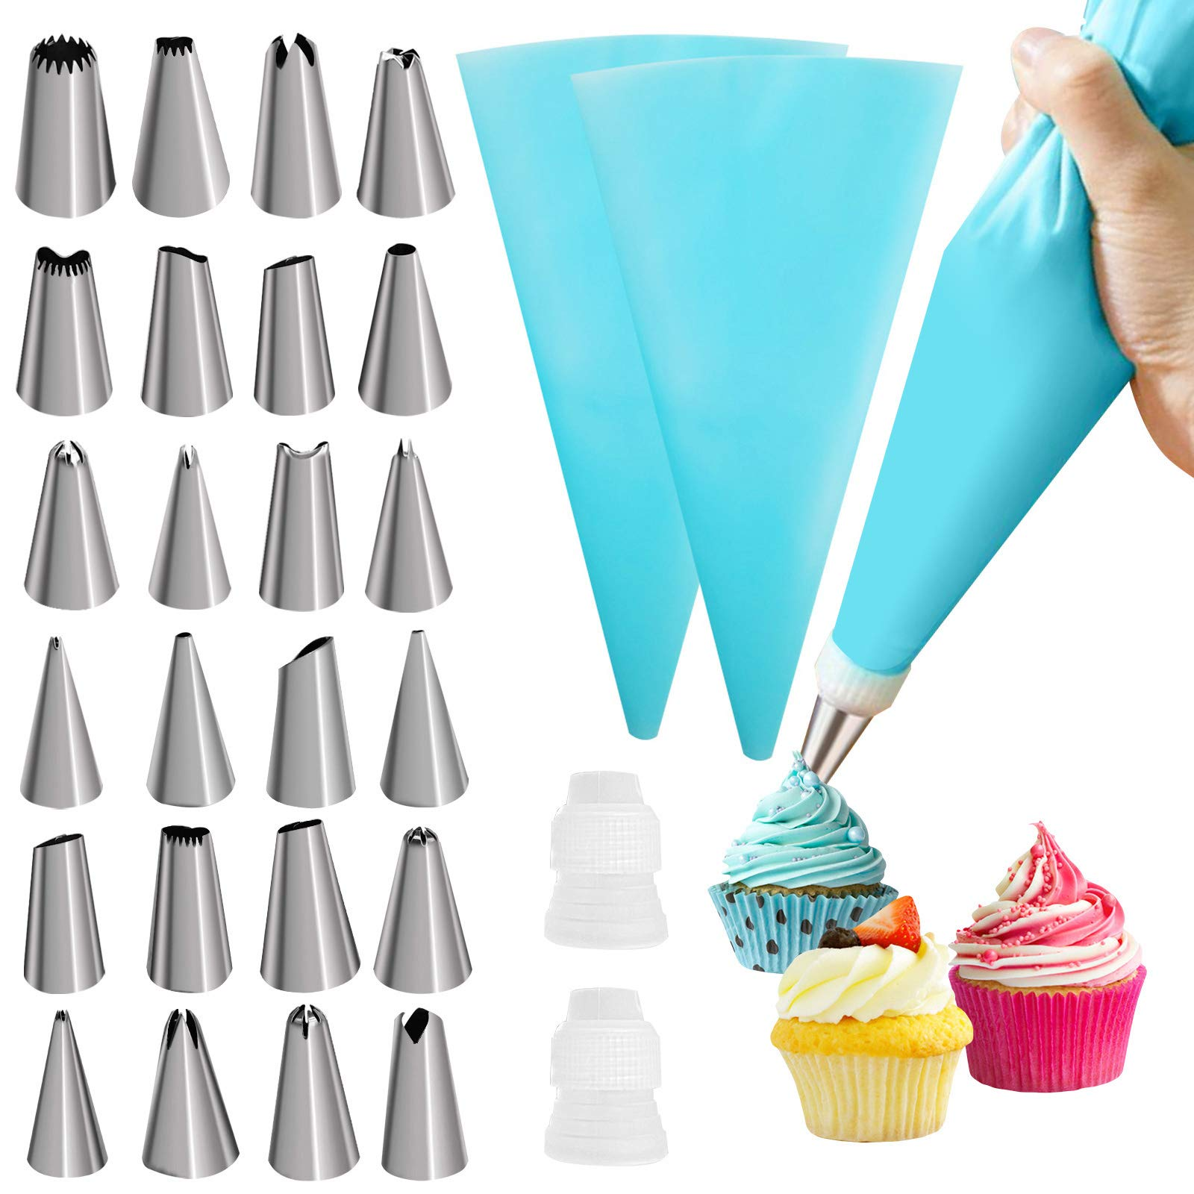
PASTRY BAG AND PIPING TIP
Used to decorate appetizers, canape, and hors d’oeuvres

Slide 38

TERRINE & GALANTINE MOLDS
Used to set meals and vegetables in gelatin/aspic mixtures

Slide 39
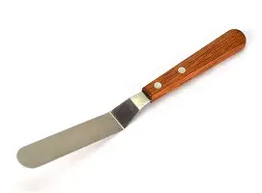
OFFSET SPATULAS/PALETTE KNIVES
Used to smoothfillings and place delicate items onto canapes and appetizers

Slide 40
RESPONSIBILITIES OF CHEF IN GARDE MANGER

Slide 41
Duties and responsibilities of the Chef Garde Manger;
He is responsible directly to the Chef de Cuisine.
He is responsible for all perishable and frozen foods stored in the Lander.
He is responsible for all cold foods that are issued from the Larder.
He is responsible for supplying different cuts, joints, of meat and fish as required by he outlet.

Slide 42
Duties and responsibilities of the Chef Garde Manger;
He is responsible for all the staff in the lander and their training.
He is responsible for Hygiene in the larder as per HACCP standards.
He is responsible for maintaining larder control, like checking for quality and quantity, storing, keeping records of issues, daily stock sheets.
He is responsible for the controlling pilfergae

Slide 43
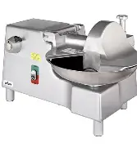
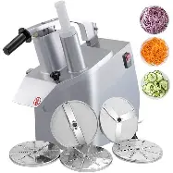
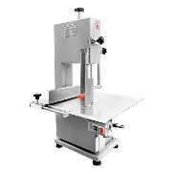
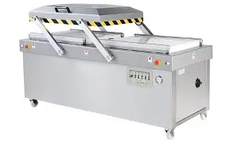
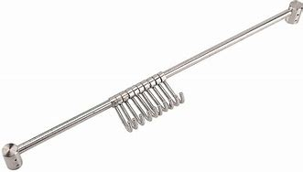

LARDER EQUEPMENT
Large or heavy duty equipment
BONE SAW MACHINE
VEGETABLE PROCESSOR
BUFFALO CHOPPER
VACCUM PACKING MACHINE
HANGING RAIL

Slide 44
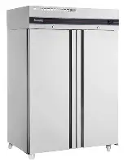
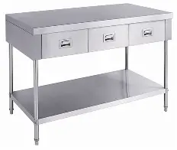
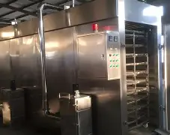
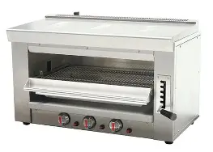
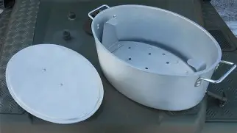
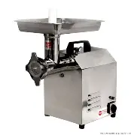
LARDER EQUEPMENT
Large or heavy duty equipment
SMOKING MACHINE
REFRIGERTOR
STEEL WORK TABLE
MINCING MACHINE
SALAMANDER
FISH KETTLE

Slide 45
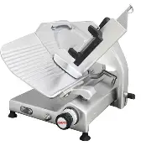
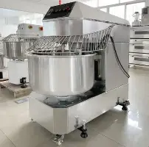
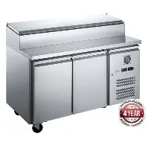
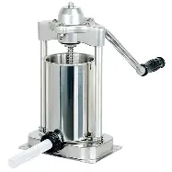
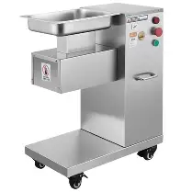

LARDER EQUEPMENT
Large or heavy duty equipment
GRAVITY OR MEAT SLICER
DOUGH MIXER
SANDWICH COUNTER
SAUSAGE STUFFER
GRIDING MACHINE
WEIGHING SCALE

Slide 46
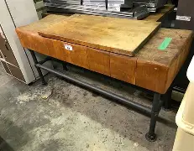
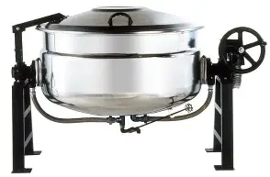
LARDER EQUEPMENT
Large or heavy duty equipment
STEAM KETTLE
BUTCHER’S BLOCK

Slide 47
OUR TEAM!!
BIASONG, FEDERICO S.
BARDAJE, JOICO JANE M.
PELENO, SHANN
TAGANA, JOHN ROY
TIU, RICA MAE JOY Y.
TUBO, QUEENIE HEART
UDTUHAN, DARREN A.
Reference;
GARDE MANGER & CHARCUTERIE | PPTX | Cooking | Food & Drink

Slide 48

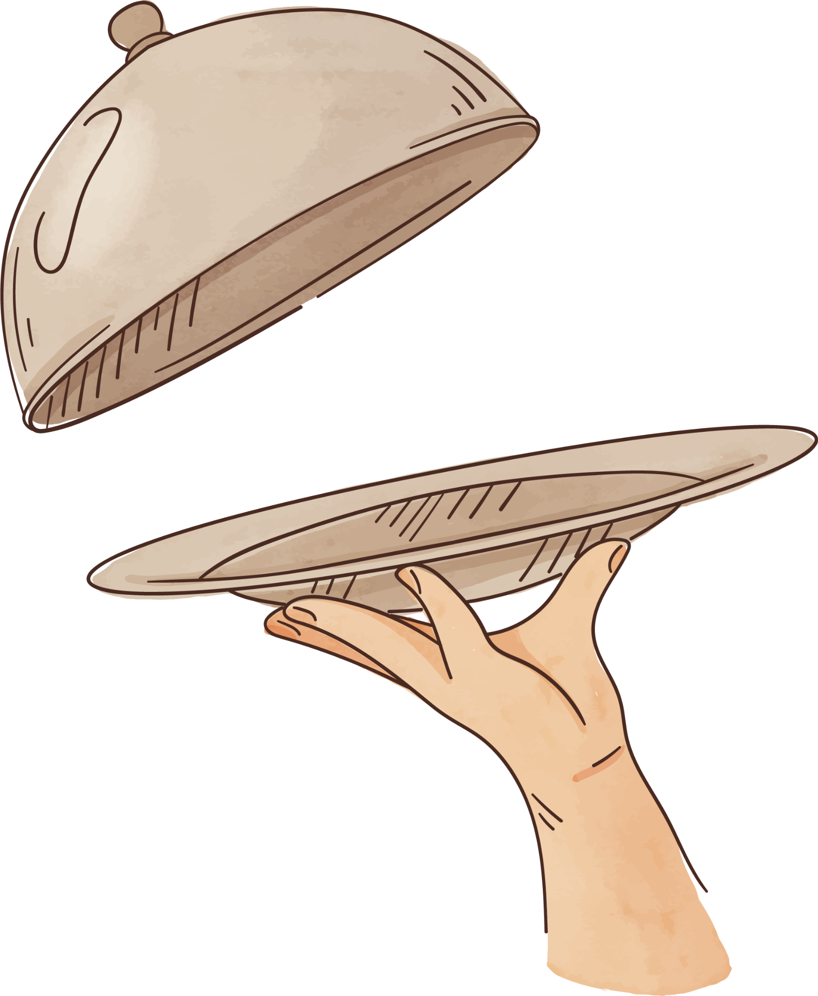

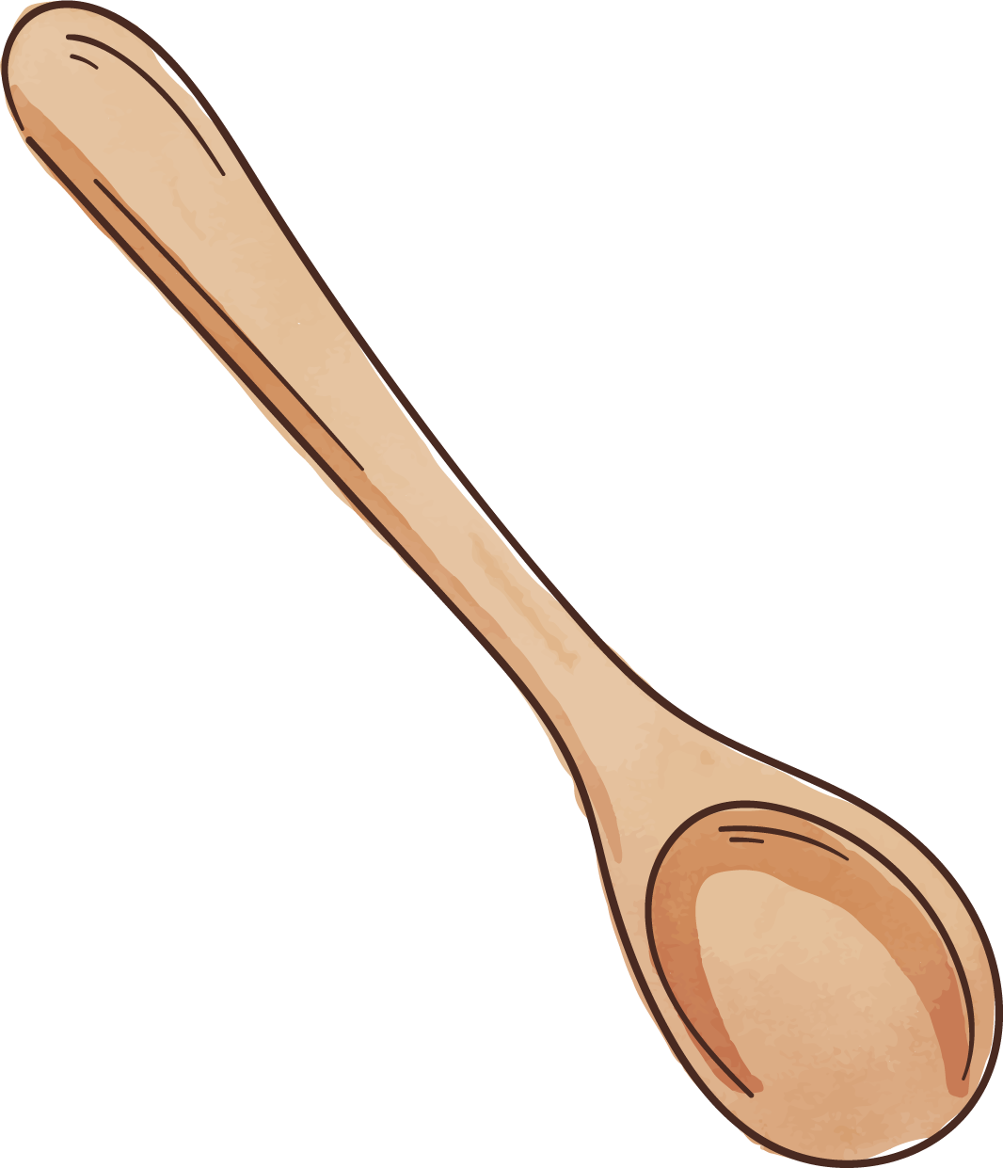

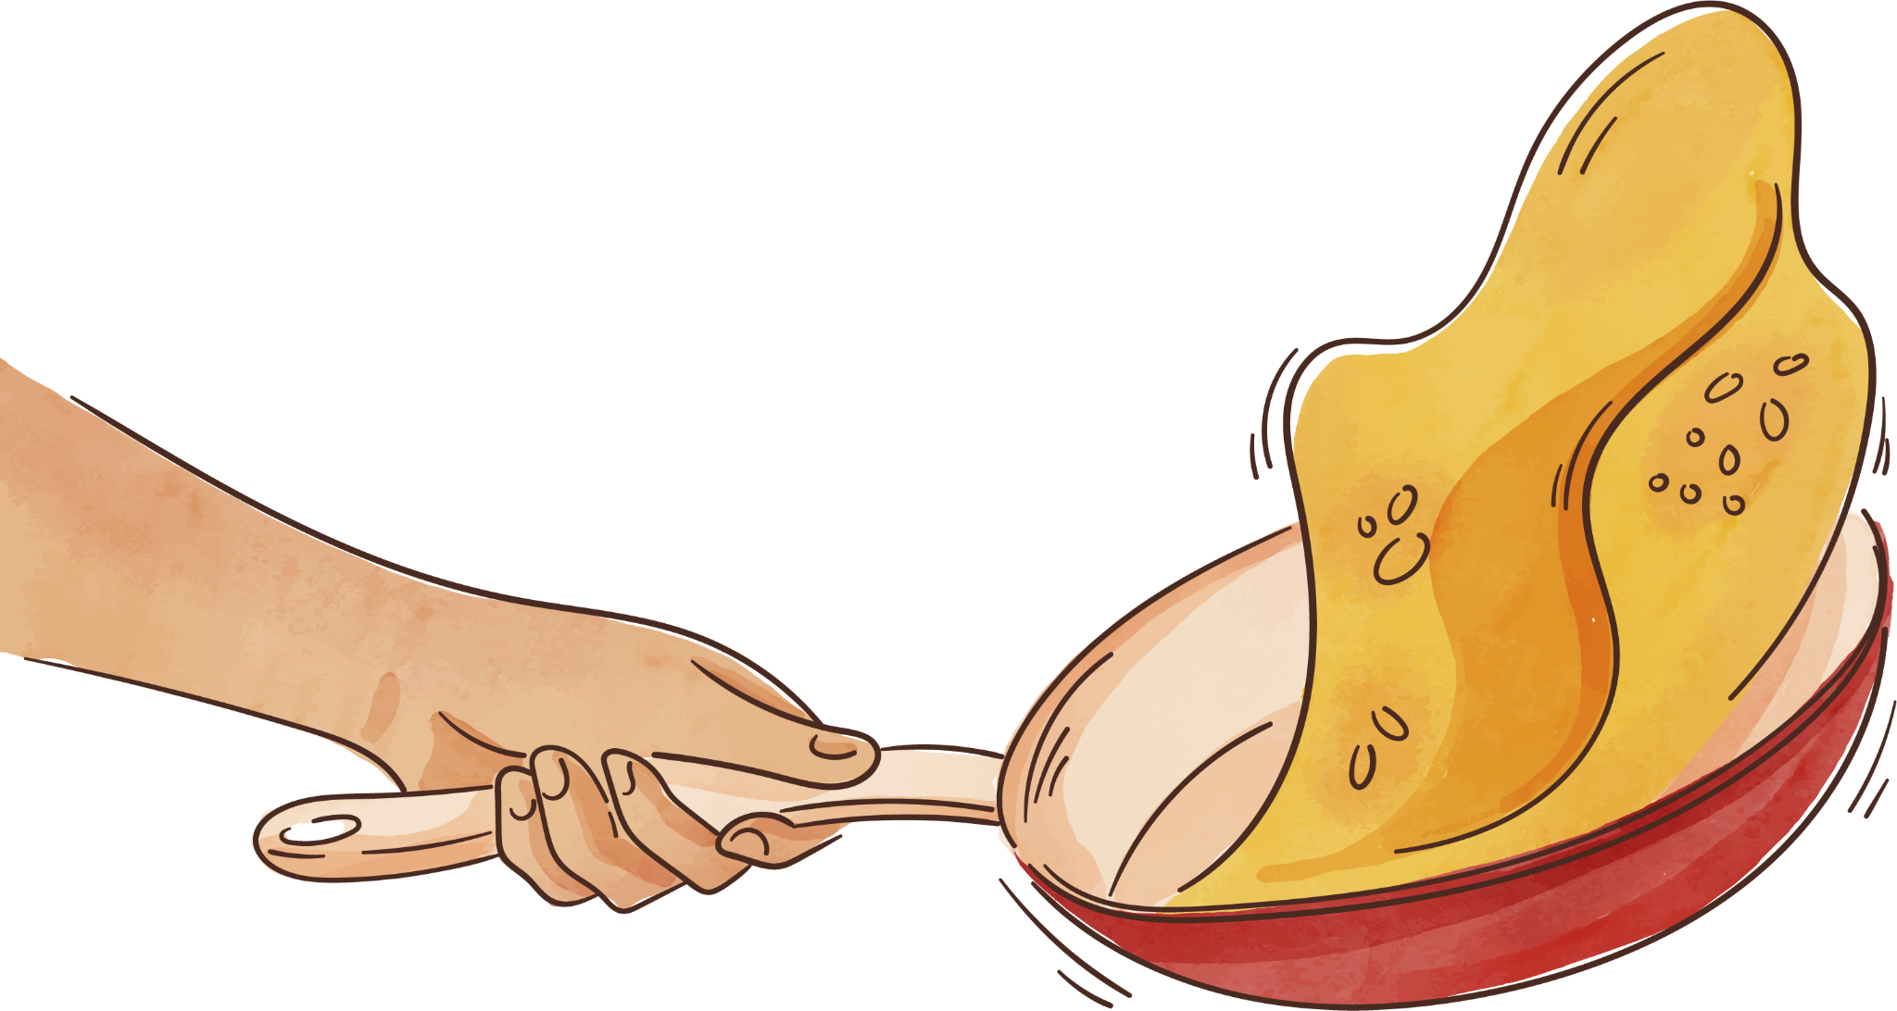
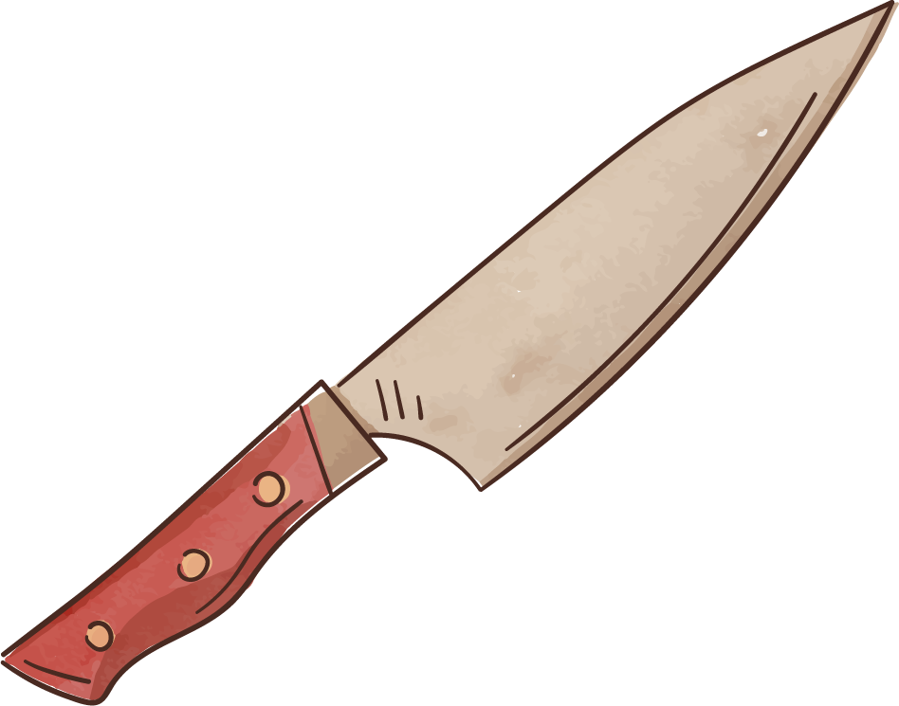
TENKS!!
MHUAA!!

